Slide 1
Sensory Organs

Slide 2
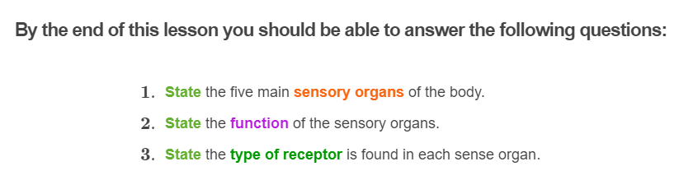
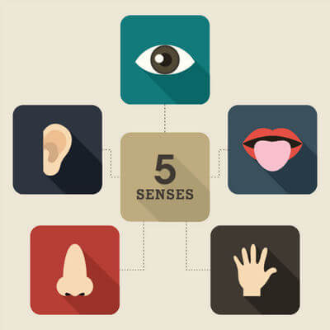

Slide 3


Your sensory organs tell you about the world around you!
How can you tell when something tastes good, that the sky is blue, or that the food at the shops smells delicious?
This is all thanks to your sensory organs! Our sensory organs allow us to obtain information from the environment all around us. This information is known as stimuli.

Slide 4

There are five sensory organs, the ear, the eye, nose, tongue and skin.
All of these sensory organs contain special types of cells which help you to detect stimuli and send the information up to your brain. This allows you to work out what you are tasting, smelling, hearing, seeing or feeling in the environment around you!
This Smart Lesson will give you a brief introduction to each of these sensory organs.

Slide 5
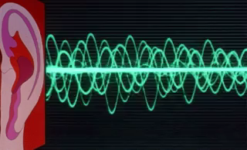
The ear is the sensory organ that detects sound.
It is responsible for all the noise that you hear in your environment. As noise enters through your outer ear, it causes vibrations which get passed on within the ear until it reaches the inner ear.
Sensory receptors in the inner ear detect the vibrations and create an electrical impulse that is transmitted to the brain, which interprets the information. This process results in you hearing a specific sound.

Slide 6

The tongue is the sensory organ that allows you to taste.
If you stick your tongue out and look in the mirror, you will notice little bumps all over the surface of your tongue. These bumps are called papilla.
Tastebuds are found down the sides of these papillae and contain many sensory cells inside them which detect chemical substances in the food and determine if it is sweet, salty, bitter or sour.

Slide 7

The eye is the sensory organ that allows you to see.
Light passes through the eye to the very back of the eyeball where the retina is. The retina is the part of the eye that contains sensory receptors which respond to light. As a result, electrical impulses are sent to the brain, allowing you to detect colour, shapes, the depth and overall image of an object.

Slide 8

The nose is the sensory organ that allows you to smell.
Olfactory cells (sensory receptors) inside the nose detect the different chemicals that enter through your nose.
An electrical impulse is then sent through the olfactory nerve to the brain which interprets the information and determines what you are smelling.

Slide 9

Your skin is the largest organ in your body. It is the sensory organ that allows you to detect touch.
The skin contains many different types of sensory receptors. These receptors allows you to detect touch, pressure, pain and the temperature of your environment.
When the sensory receptors in the skin are activated, an electrical impulse is generated, and transmitted to the brain to inform you about your environment.

Slide 10
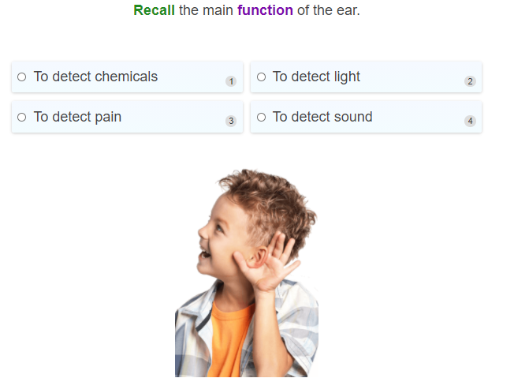

Slide 11
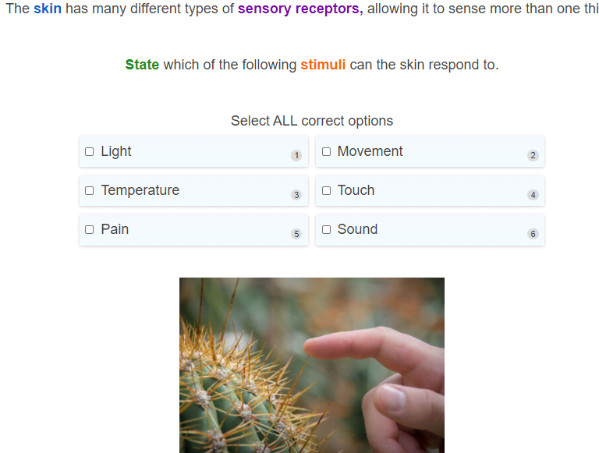

Slide 12
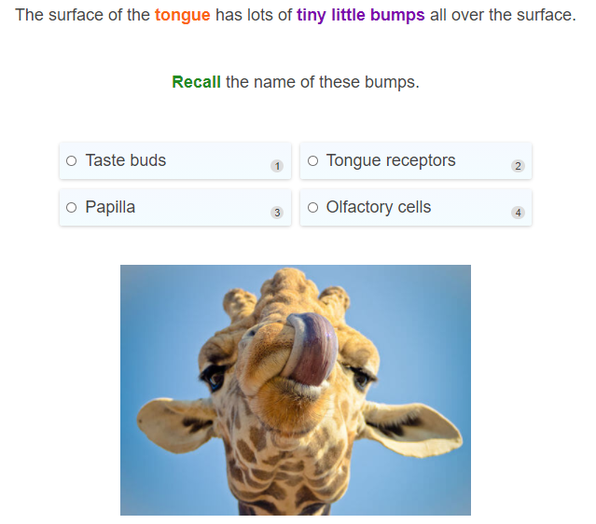

Slide 13
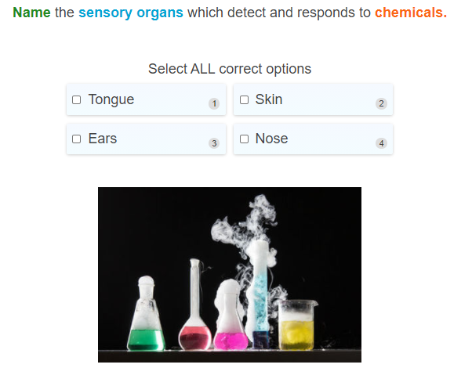

Slide 14
There are five different sensory receptors which are found in your sensory organs.
These sensory receptors are what help you to detect the information about your environment. The receptors sense the stimuli and sends an electrical impulse to through sensory neurons to your brain which processes and interprets the information.
As a result, you are able to smell, taste, see, hear and touch!

Slide 15

Chemoreceptors detect chemical stimuli such as the chemicals in what we eat and smell.
Chemoreceptors convey messages about these chemicals to the brain so that we know whether something smells awful or nice.
These sensory receptors are found in the tongue, within the tastebuds, and in the nose.
There are many different types of chemoreceptors that respond to different chemicals. In the tongue there are different chemoreceptors to detect whether the food is salty, sweet, bitter, or sour.

Slide 16

Thermoreceptors are sensory receptors that detect variations in temperature.
These sensory receptors are found in the skin and in the hypothalamus, which is the part of your brain involved in regulating body temperature.
There are thermoreceptors that specifically detect heat, while others specifically detect cold.
Different areas of the skin may also contain more thermoreceptors than others. For example, the hand contains more thermoreceptors than the thigh, which means that the hand is more sensitive to temperature changes!

Slide 17
Mechanoreceptors are sensory receptors that detect touch, pressure, vibrations, and movement.
These sensory receptors can be found in the skin and in the tiny hairs within the inner ear.
Mechanoreceptors found on the skin respond to movement and touch.
In the ear, the mechanoreceptors respond to vibrations that are sent through to the inner ear, resulting in movement of the tiny hairs. This causes an electrical impulse to be generated and sent along sensory neurons to the brain and the information is interpreted as sound.

Slide 18

Photoreceptors are sensory receptors that detect light.
These sensory receptors are only found at the back of the eye in the retina and convert the light it detects into electrical impulses. These impulses are transmitted across a series of neurons and go to the brain which interprets the information as an image.

Slide 19

Pain receptors are sensory receptors that help you to respond to chemicals that have been released from damaged cells.
Detection of pain is important as it can be an indication of an injury, danger or disease.
These receptors can be found in your skin, muscles, and all throughout your body except for the brain!

Slide 20
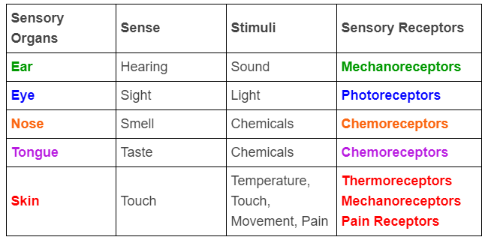
To help you remember everything, here is a summary of the sensory organs and the sensory receptors!

Slide 21
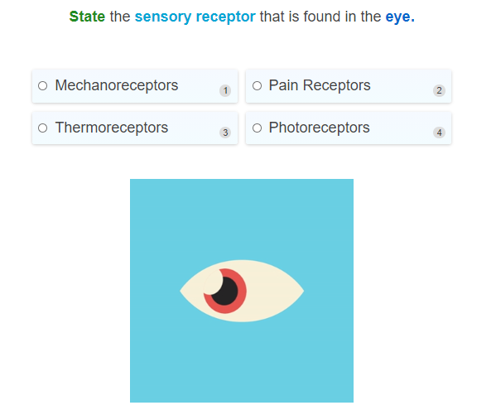

Slide 22
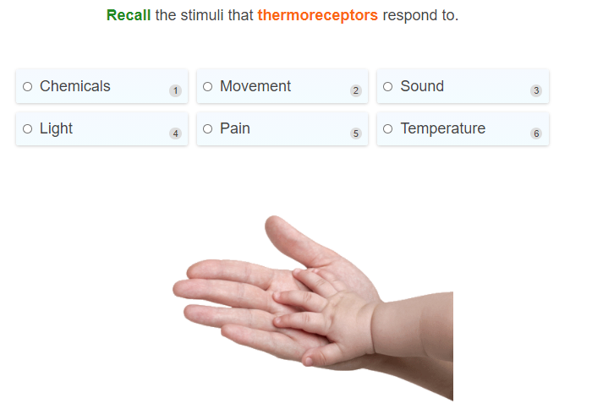

Slide 23
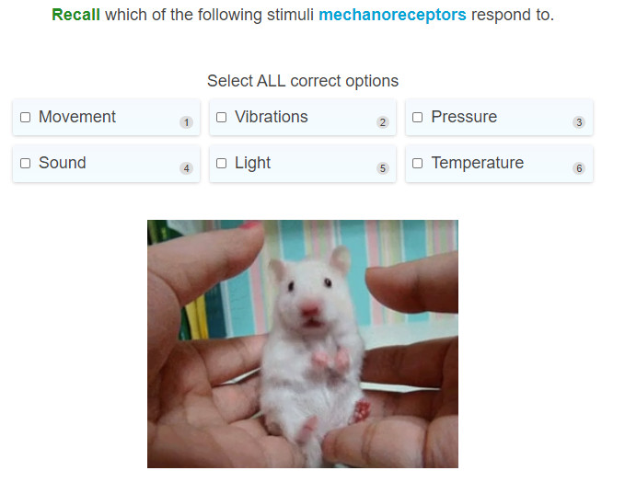

Slide 24
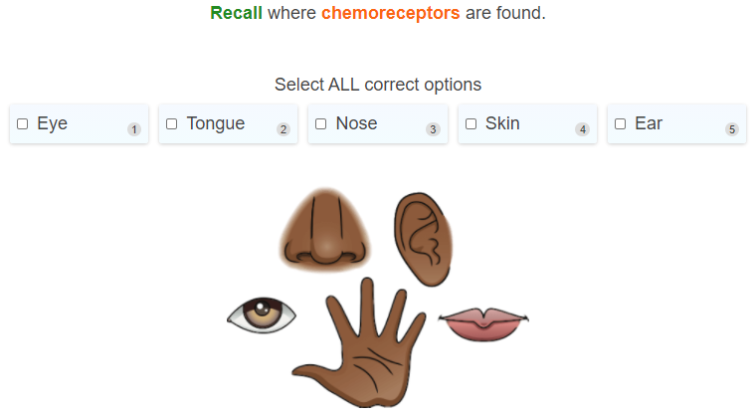

Slide 25
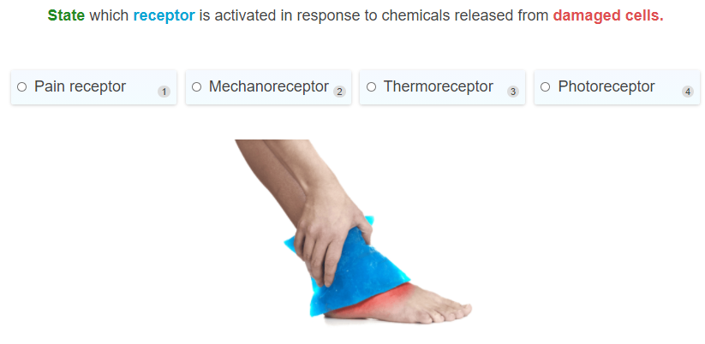

Slide 26

Two of our sensory organs are closely related and work together.
This is the nose and the tongue!
In fact, it is both the nose and the tongue which work together to help you to establish the flavour of different foods.

Slide 27
The chemoreceptors in the nose and the tongue both detect chemicals.
It is no wonder that these two work together to help you to identify flavours of food.
When you take a bite of pizza, the taste buds on your tongue contain receptors which detect the chemical makeup of the food. Taste buds can differentiate between 5 basic tastes: salty, sweet, sour, bitter and umami (a savoury taste).

Slide 28

Since our taste buds can only differentiate between 5 tastes, it is important for us to be able to smell the food in order to be able to work out its flavour.
This is why we sometimes can't distinguish one flavour from another when we have a blocked nose and can't smell! Our nose contains around 450 different chemoreceptors that each detect a different odour, or smell. Combined, the chemicals detected on the tongue and in the nose help us to detect so many different flavours.

Slide 29
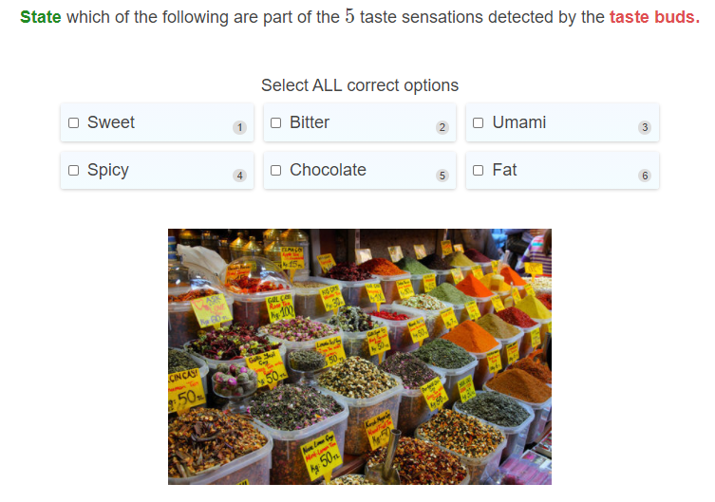

Slide 30
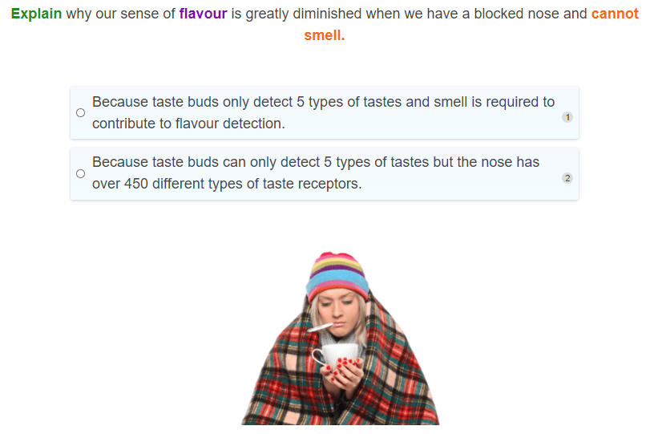

Slide 31
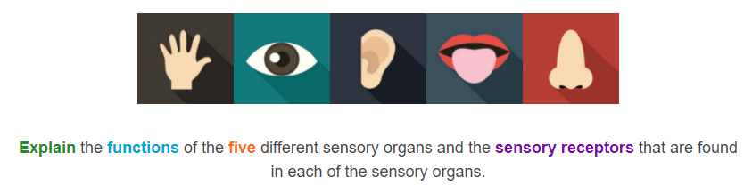

Slide 32


